Slide 1
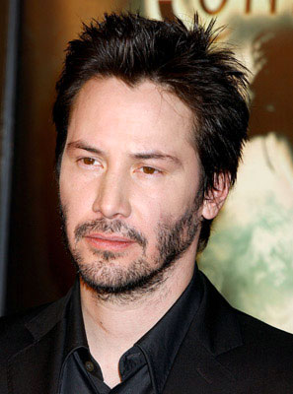

L.O.S.T
Logically Oriented Software Technology
a post mortem analysis
Rasmus Tilljander
Erik Hörlin
Kim Hansson
Calle Ketola
DV1435
Fördjupning i objektorienterade tekniker

Slide 2
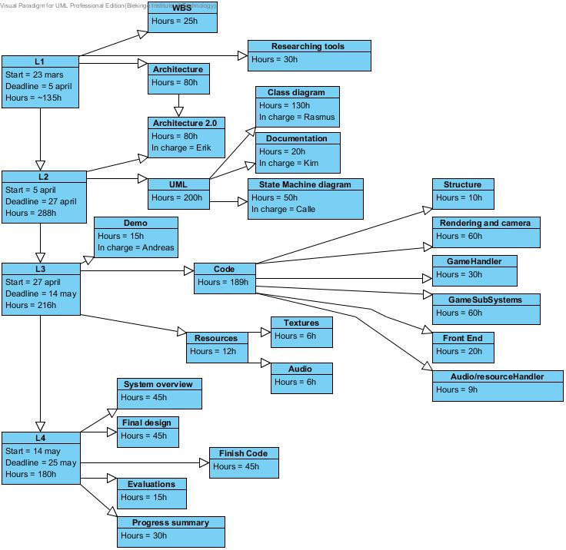
Prequel
First WBS version

Slide 3
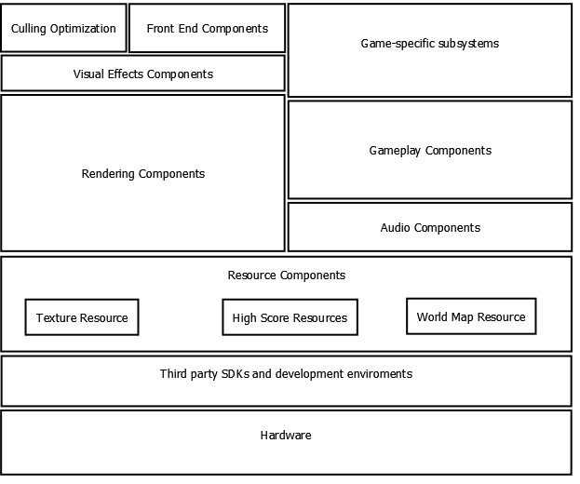
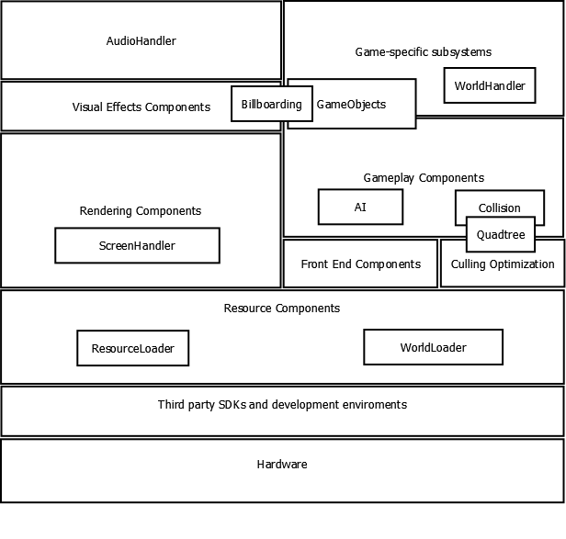
First Architecture
Final Architecture

Slide 4
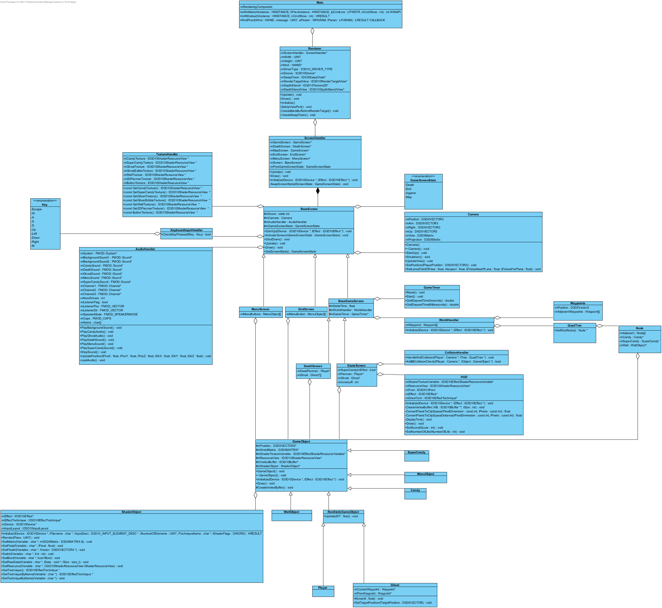
Class Diagram

Slide 5
Proudest Design Moments
۞
Observer pattern for Screen handler
۞
Waypoint system for ghost AI

Slide 6
Problems Encountered
The only real problems we encountered where related to the code.
۞ Implementing billboards
۞Reference driver mistake

Slide 7
Product metrics
۞ Planned time vs. Spent time
۞ Requested features vs. Implemented features

Slide 8
Summary
۞
Time estimates are hard
۞
Compromises are unavoidable

Slide 9

Fin

